Slide 1
Loan Approval Prediction Using Machine Learning
Submitted To:Naviotech Solution pvt.Ltd
Submitted By: Priyanka Pawar
Domain:Artificial Intelligence/Machine Learning
March 2016

Slide 2
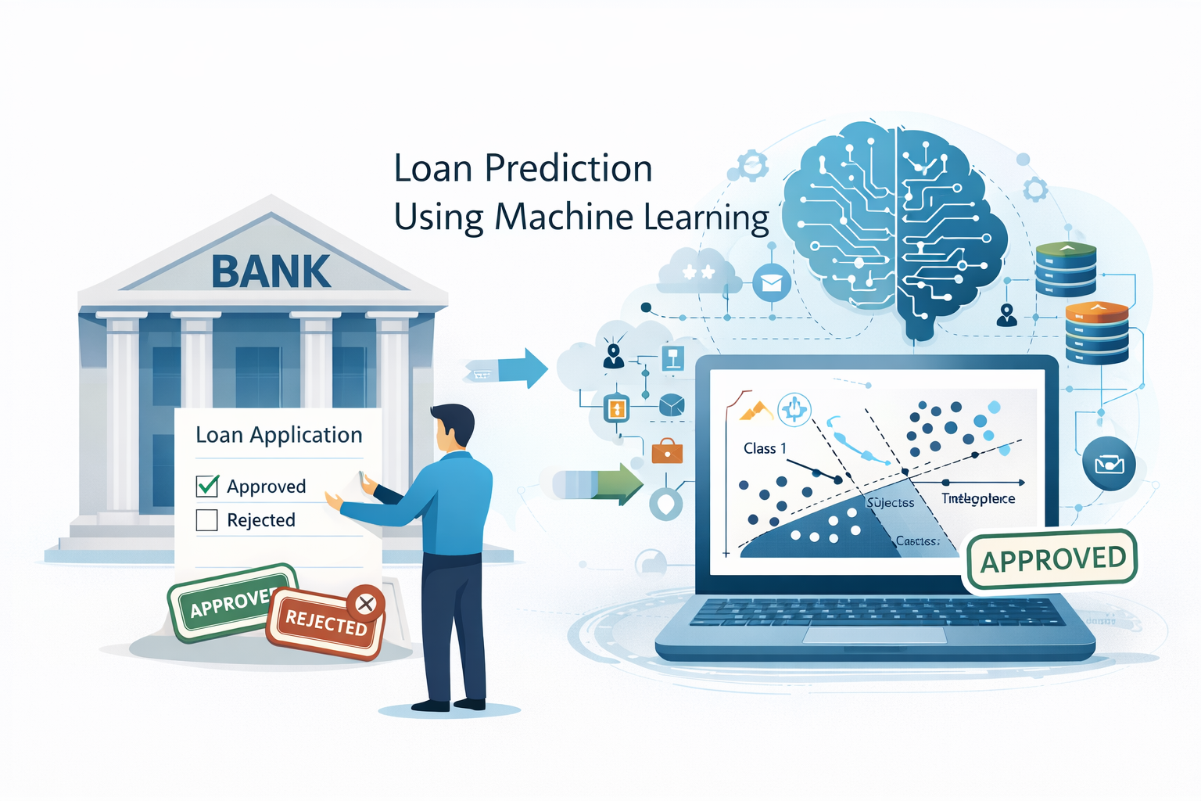
Introduction
Loan prediction is a Machine Learning project used to predict whether a loan will be approved or not.
Banks receive many loan applications.
This system helps banks:
Reduce risk
Save time
Make fast decisions
We use Machine Learning classification
algorithm for prediction.

Slide 3
Objective of Project
To predict loan approval status
To analyze applicant data
To build a classification model
To improve decision-making process

Slide 4
Technologies Used
Python
NumPy – Numerical operations
Pandas – Data handling
Seaborn – Data visualization
Scikit-learn – Machine Learning
SVM Algorithm

Slide 5
Dataset Information
Dataset contains details of loan applicants:
Gender
Married
Dependents
Education
Self Employed
Income
Loan Amount
Property Area
Loan Status (Target)
Target Variable:
Loan_Status (Y = Approved, N = Not Approved)

Slide 6
Data Preprocessing
Steps performed:
Checked missing values
Removed missing data using dropna()
Converted categorical data into numerical form
Replaced:
Y → 1
N → 0
3+ → 4
Data cleaning is important for accurate prediction.

Slide 7
Data Visualization
Used Seaborn Countplot to analyze:
Education vs Loan Status
Marital Status vs Loan Status
This helps understand which category gets more loan approval.

Slide 8
Feature Selection
Separated:
X (Features) → Input data
Y (Target) → Loan_Status
Then divided data into:
Training Data (90%)
Testing Data (10%)
Using:
train_test_split()

Slide 9
Machine Learning Model
Used:
Support Vector Machine (SVM)
SVM is a classification algorithm.
It separates data using a hyperplane.
In this project:
svm.SVC(kernel='linear')

Slide 10
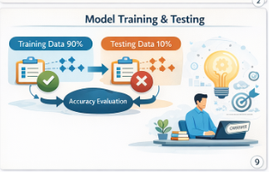
Model Training
Model trained using training data
Used .fit() function
After training:
Model learned patterns from data

Slide 11
Accuracy Result
Accuracy on Training Data : 0.7986111111111112
Accuracy on Testing Data : 0.8333333333333334
Accuracy Score calculated using:
accuracy_score()
Higher accuracy means better prediction performance.

Slide 12
Conclusion
Successfully built Loan Prediction Model
Used SVM algorithm
Performed data cleaning & visualization
Achieved good accuracy
Can help banks in decision making

